Slide 1


ENIPRO TRADE X
Discussing our FinTech by Group 2
...Building Trust in the Digital Age

Slide 2
ENIPRO TRADE X
Table of Contents
Points to discuss:
About ENIPRO TRADE X and Current Trend of the Crypto Industry in Nigeria
01
Key Stakeholders of our Platform
06
Interview and Survey Questions for our various Stakeholders
07
Potential Users of our Platform and their needs
02
Analysis Techniques to identify Opportunities and Challenges of our Platform
08
SWOT analysis of the Proposed ENIPRO TRADE X Platform
03
BCD and BMC of our Platform
04
SDLC of our Platform using Agile Methodology
09
Functional and Non Functional Requirements of our Platform
05
DFD of our Platform and User Acceptance Stories
10

Slide 3

About Enipro Trade X
Founded in April 2017 by Nigeria born Business Analysts.
Our Vision is to provide a user friendly platform, wide acceptability, trust and recognition, and affordable transaction fees for Nigerians, Africans and the entire globe against foreign competitors as Binance, Quidax etc.
Creating awareness for digital economy across Africa.

Slide 4
Market Overview.
Nigeria has emerged as one of the leading markets for cryptocurrency adoption in Africa, with a significant number of individuals and businesses actively participating in trading and investment activities. Platforms like Binance, Luno, and Quidax have gained popularity among Nigerian users, offering easy access to a variety of cryptocurrencies such as Bitcoin, Ethereum, and Ripple.
Current Cryptocurrency state in Nigeria.
Increased Institutional Involvement
Regulatory Clarity
Growing Adoption
Emergence of Decentralized Finance (DeFi)
Interoperability and Cross-Chain Solutions
Focus on Sustainability and Energy Efficiency
Rise of Central Bank Digital Currencies (CBDCs)
Current Cryptocurrency challenges in Nigeria.
Complexity and Technical Barriers
Security Concerns
Regulatory Uncertainty
Liquidity and Market Fragmentation
Volatility
User Experience and Interface Design

Slide 5
Users of our Platform and their Needs
Users and Needs
What our platform would do for Users
Investors and Traders: Individuals seeking investment opportunities or engaging in speculative trading.
Merchants: Businesses looking for alternative payment solutions and lower transaction fees.
Developers: Those interested in building decentralized applications (DApps) or contributing to blockchain projects.
Consumers: People interested in using cryptocurrencies for everyday transactions or as a store of value.
Institutional Investors: Hedge funds, asset managers, and other financial institutions exploring cryptocurrency investment opportunities.
Governments and Regulators: Entities interested in understanding and potentially regulating the cryptocurrency market.
Security: Secure storage and transactions to protect their assets from hacks and theft.
Liquidity: Access to liquid markets to buy, sell, and trade cryptocurrencies easily.
Transparency: Clear and reliable information about market trends, prices, and project fundamentals.
Regulatory Compliance: Assurance that various stakeholders are operating within legal frameworks and compliance standards.
User-Friendly Interfaces: Intuitive platforms and applications for managing their cryptocurrency investments and transactions.
Scalability: Blockchain networks that is capable of handling increasing transaction volumes without congestion.

Slide 6
SWOT Analysis of ENIPRO TRADE X
STRENGTHS
WEAKNESS
Decentralization
Innovation
Global Accessibility
Financial Inclusion
Security
User-Friendly Interface
Diverse Range of Cryptocurrencies
Volatility
Regulatory Uncertainty
Scalability Issues
Perception
Security Risks
Technical Issues
Customer Support
OPPORTUNITIES
THREATS
Mainstream Adoption
Institutional Investment
Tokenization of Assets
Emerging Markets
Technological Advancements
Expansion of Services
Educational Resources
Global Reach
Regulatory Crackdowns
Security Breaches
Market Manipulation
Competing Technologies
Technological Risks

Slide 7
BUSINESS CASE DOCUMENT (BCD)
Executive Summary: Our company aims to address the lack of user-friendly and secure platforms for buying, selling, and exchanging cryptocurrencies by developing a fintech platform.
Problem Statement: The cryptocurrency market lacks user-friendly and secure platforms for exchanging digital assets.
Solution: Our fintech platform will provide a user-friendly interface that simplifies the process of buying, selling, and exchanging cryptocurrencies.
Target Market: Our target market includes both novice and experienced cryptocurrency investors who seek a user-friendly and secure platform for trading digital assets.
Competitive Analysis: While several cryptocurrency exchanges exist in the market, few prioritize both user-friendliness and security.
Revenue Model: Our revenue model will primarily rely on transaction fees incurred from trades conducted on the platform.
Marketing Strategy: Our marketing strategy will focus on targeting cryptocurrency enthusiasts through social media, online communities, and targeted advertising.
Development Plan: The development plan will consist of iterative stages, starting with the design and development of the platform's core features.
Risk Analysis: Key risks include regulatory uncertainties, cybersecurity threats, and market volatility.
Conclusion: Our fintech platform aims to revolutionize the cryptocurrency trading experience by offering a user-friendly and secure solution.

Slide 8
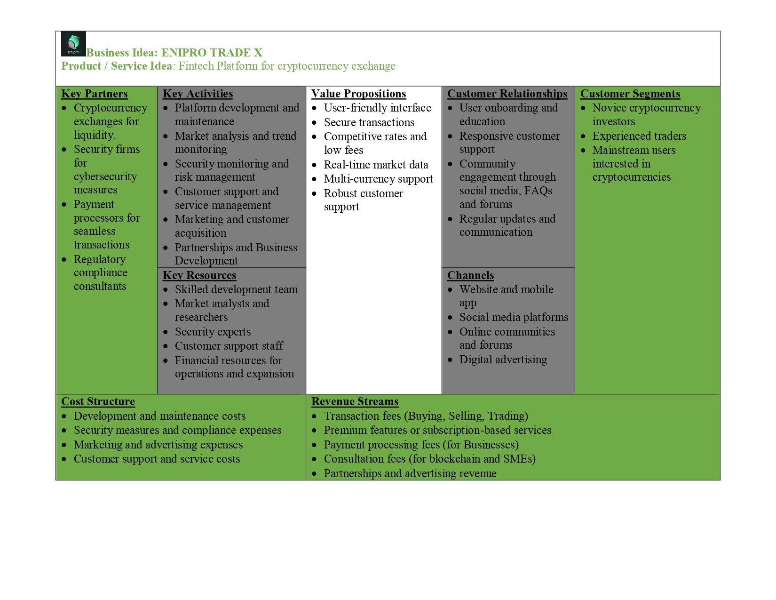
BUSINESS MODEL CANVAS (BMC)

Slide 9


FUNCTIONAL AND NON FUNCTIONAL REQUIREMENTS OF ENIPRO TRADE X
FUNCTIONAL REQUIREMENTS
NON-FUNCTIONAL REQUIREMENTS
User Registration and Authentication: Allow users to register with the platform using email, phone number, or social media accounts.
Wallet Management: Enable users to create and manage cryptocurrency wallets for different digital assets.
Trading Platform: Provide a user-friendly interface for buying and selling cryptocurrencies.
Portfolio Tracking: Offer tools for users to track their cryptocurrency holdings and portfolio performance.
Payment Integration: Integrate with payment gateways to allow users to fund their accounts using fiat currencies.
Security Measures: Implement robust security measures to protect user funds and personal information.
Compliance and Regulation: Ensure compliance with relevant financial regulations and KYC (Know Your Customer) requirements.
API Integration: Provide application programming interfaces (APIs) for developers to integrate cryptocurrency trading functionality into third-party applications and services.
Performance: The platform should be highly responsive, with low latency for executing trades and loading data.
Scalability: Design the platform to scale horizontally to accommodate increasing user traffic and transaction volume.
Reliability: Maintain high availability of services, with minimal downtime for scheduled maintenance or unexpected outages.
Security: Employ industry-standard encryption protocols to protect sensitive user data and financial transactions.
Regulatory Compliance: Ensure that the platform complies with relevant financial regulations and follows best practices for data protection and privacy.
Usability: Design an intuitive user interface that is easy to navigate and understand, even for users with limited experience in cryptocurrency trading.

Slide 10
STAKEHOLDERS INVOLVED IN DEVELOPMENT AND USE OF OUR PLATFORM
USERS/INVESTORS
FINANCIAL INSTITUTIONS
Individual investors/traders
Institutional investors
Retail investors
Banks and payment processors
Investment firms
MINING INDUSTRY
DEVELOPERS
Cryptocurrency miners
Mining hardware manufacturers
Blockchain developers
Cryptocurrency developers
EXCHANGES AND TRADING PLATFORMS
MEDIA AND INFLUENCERS
Cryptocurrency exchanges
Over-the-counter (OTC) desks
Cryptocurrency news outlets
Social media influencers
REGULATORS AND GOVERNMENTS
LEGAL AND COMPLIANCE CONSULTANTS
Regulatory agencies
Central banks
Government agencies
Legal firms
Compliance consultants
BLOCKCHAIN AND CRYPTOCURRENCY COMMUNITIES
Advocacy groups
Open-source communities

Slide 11
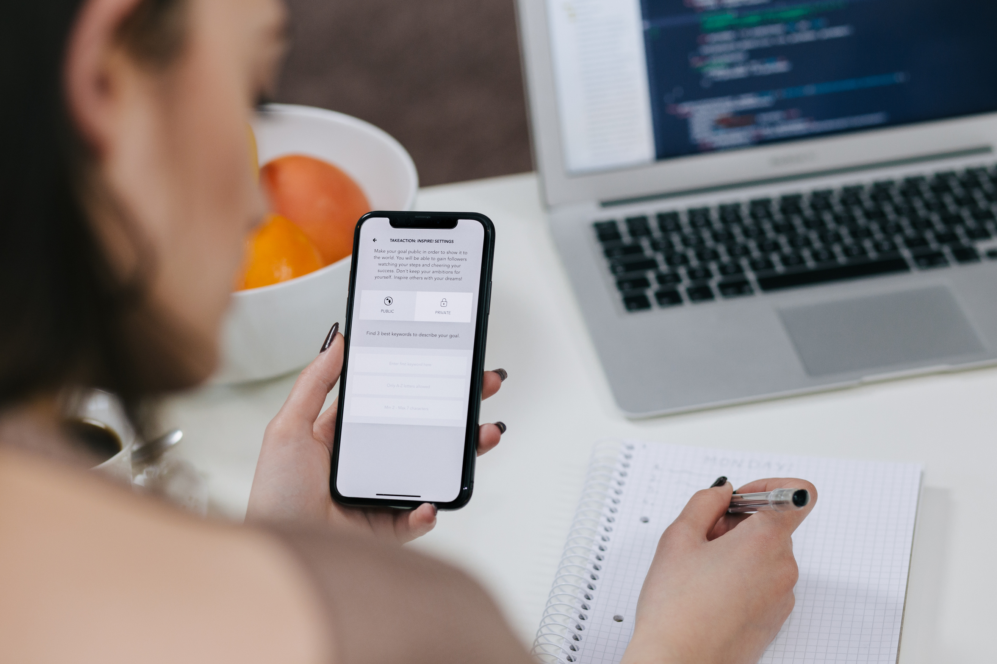
SURVEY AND INTERVIEW QUESTIONS FOR ENIPRO TRADE X STAKEHOLDERS
For the individual investors
A total of 350 respondents responded to our survey forms, also our respondents were from various states of the country.
How did you first become interested in cryptocurrency investing?
What factors do you consider when choosing a cryptocurrency platform for trading or investing? https://forms.gle/KLeB7txNPZK1MF6h7
Institutional investors
For the institutional investors we visited Ten (10) institutions across the country, for the sake of confidentiality, their names would be withheld due to data privacy.
What factors influence your decision to invest in cryptocurrencies as an institutional investor? https://forms.gle/2g7QmyzvRJHbgNc38
Traders
For crypto traders, we had a total of 300 respondents from the survey
What trading strategies do you employ in the cryptocurrency market?
How do you assess market trends and sentiment when making trading decisions? https://forms.gle/vPur6vaqytWBDF7t8
Developers
What motivated you to start developing decentralized applications (DApps) or smart contracts on blockchain platforms?
What challenges do you encounter when building and deploying DApps or smart contracts? https://forms.office.com/r/8JL07L3j8q

Slide 12
PESTLE ANALYSIS TECHNIQUES TO IDENTIFY OPPORTUNITIES AND CHALLENGES OF OUR PLATFORM
POLITICAL
Opportunity: Favorable regulatory environments in some jurisdictions may encourage innovation and investment.
Challenge: Regulatory uncertainty and inconsistencies between countries can create compliance burdens and hinder market growth
ECONOMIC
Opportunity: Cryptocurrencies can provide an alternative investment asset class, offering potential high returns for investors.
Challenge: Economic instability, inflation, and currency devaluation in certain regions may drive individuals to seek refuge in cryptocurrencies, but volatility remains a concern.
SOCIAL
How we deal with money has indeed been improved by advances in technology, encouraging us to invest in our future better.
Opportunity: Increasing awareness and acceptance of cryptocurrencies among the general population may lead to broader adoption for various use cases.
Challenge: Negative perceptions of cryptocurrencies due to associations with illicit activities and scams may deter regulatory acceptance.
TECHNOLOGICAL
Opportunity: Technological advancements, such as scalability solutions, interoperability protocols, and privacy-enhancing technologies, can address current limitations and drive innovation in the cryptocurrency market.
Challenge: Security vulnerabilities, hacks, and technological flaws in blockchain networks and cryptocurrency platforms pose risks to user funds and undermine trust in the ecosystem.
LEGAL
Opportunity: Clarity and consistency in regulatory frameworks can provide a conducive environment for businesses and investors to operate in the cryptocurrency market, fostering confidence and legitimacy.
Challenge: Evolving regulatory landscape and potential crackdowns or bans on cryptocurrencies in certain jurisdictions can create uncertainty and compliance challenges for market participants.
ENVIRONMENTAL
Opportunity: Growing concerns about the environmental impact of traditional proof-of-work (PoW) mining algorithms may drive adoption of more energy-efficient consensus mechanisms, such as proof-of-stake (PoS) or delegated proof-of-stake (DPoS).
Challenge: The energy consumption associated with cryptocurrency mining, particularly for PoW-based cryptocurrencies like Bitcoin, continues to raise environmental concerns and may face scrutiny from regulators and stakeholders.

Slide 13
SOFTWARE DEVELOPMENT LIFECYCLE (SDLC) FOR OUR PLATFORM USING AGILE METHODOLOGY
Project initiation
Continuous integration and testing
Product Vision
Stakeholder Identification
Initial Backlog
Automated Testing
Continuous Integration (CI)
Code Reviews
Release planning
Feedback and adaptation
Product Roadmap
Sprint Planning
Estimation
Team Formation
Product Feedback
Retrospectives
Adaptation
Iterative development (sprints)
Release and deployment
Sprint Execution
Daily Standups
Continuous Integration
Incremental Delivery
Sprint Review
Release Planning
User Acceptance Testing (UAT):
Deployment
Monitoring and Support
Iterative improvement
Metrics and Analytics
Continuous Improvement

Slide 14

Our User Stories, User Acceptance Criteria for our Platform
...BUILDING TRUST IN THE DIGITAL AGE

Slide 15
User Story 1
User Acceptance Criteria
As a user, I want to be able to access real-time market data on the crypto platform so that I can make informed decisions about my trades.
The platform should provide real-time updates on cryptocurrency prices, including current market value, highs, lows, and volume.
User Story 2
User Acceptance Criteria
As a user, I want to be able to securely register and verify my account on the crypto platform to ensure the safety of my funds and personal information.
The platform should require users to provide basic information such as name, email address, and password for account registration.
User Story 3
User Acceptance Criteria
As a user, I want to be able to easily deposit funds into my account and withdraw funds when needed, with minimal hassle and quick processing times.
The platform should support multiple payment methods for deposits, including bank transfers, credit/debit cards, and cryptocurrency deposits.
User Story 4
User Acceptance Criteria
As a user, I want to have an intuitive and user-friendly interface for executing trades and managing my portfolio on the crypto platform.
The trading interface should be easy to navigate, with clear labels and visual indicators for different trading pairs.
User Story 5
User Acceptance Criteria
As a user, I want to have access to reliable customer support services on the crypto platform to address any issues or concerns that may arise during my trading activities.
The platform should offer multiple channels for customer support, including live chat, email support, and a dedicated support ticket system.

Slide 16
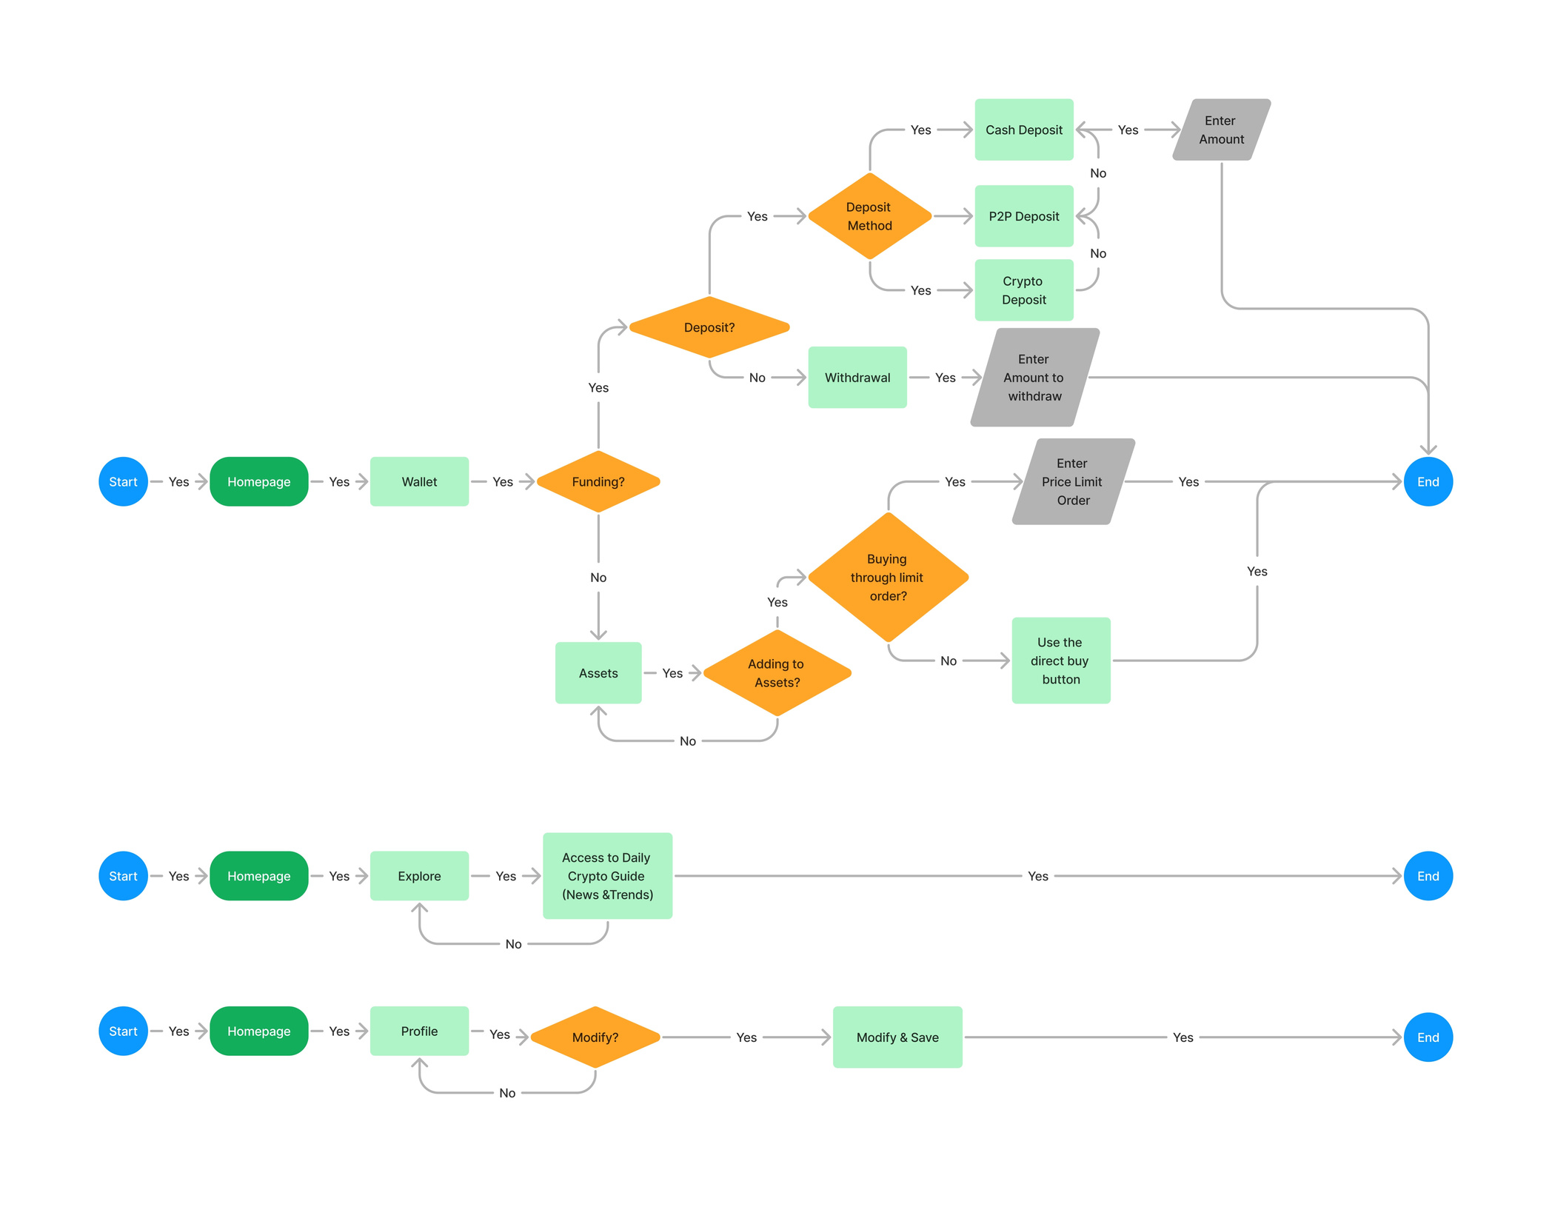
























DATA FLOW DIAGRAM (DFD)OF THE DIFFERENT COMPONENTS OF OUR PLATFORM
Free Resources
Use these free recolorable icons and illustrations in your Canva design

Slide 17

ENIPRO TRADE X
THANK YOU
Do you have any questions?
Send it to us! info@eniprotradex.com

